Slide 1
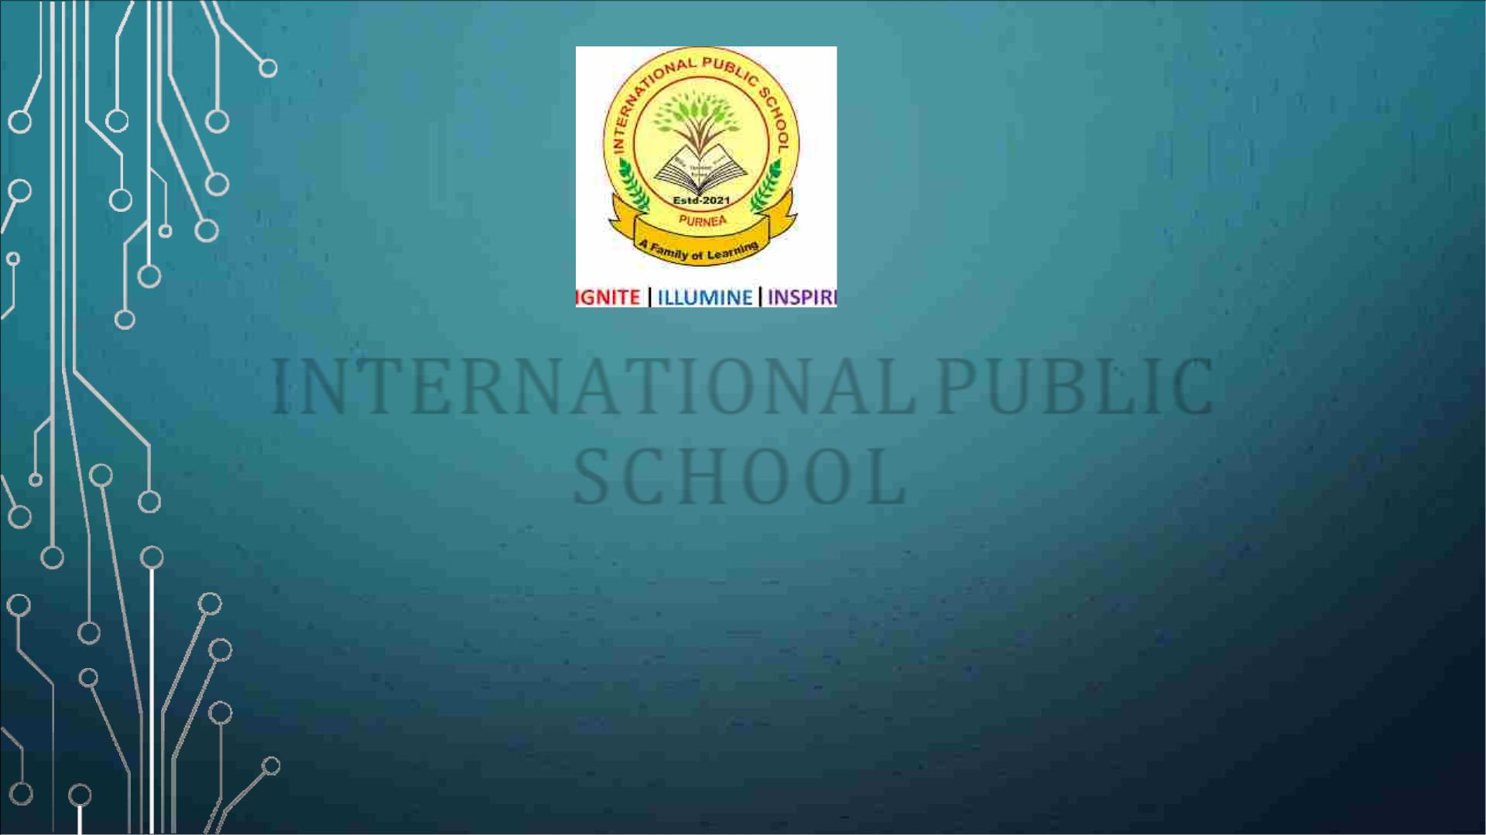
INTERNATIONAL PUBLIC
SCHOOL
PRESENTS
NEWSLETTER

Slide 2
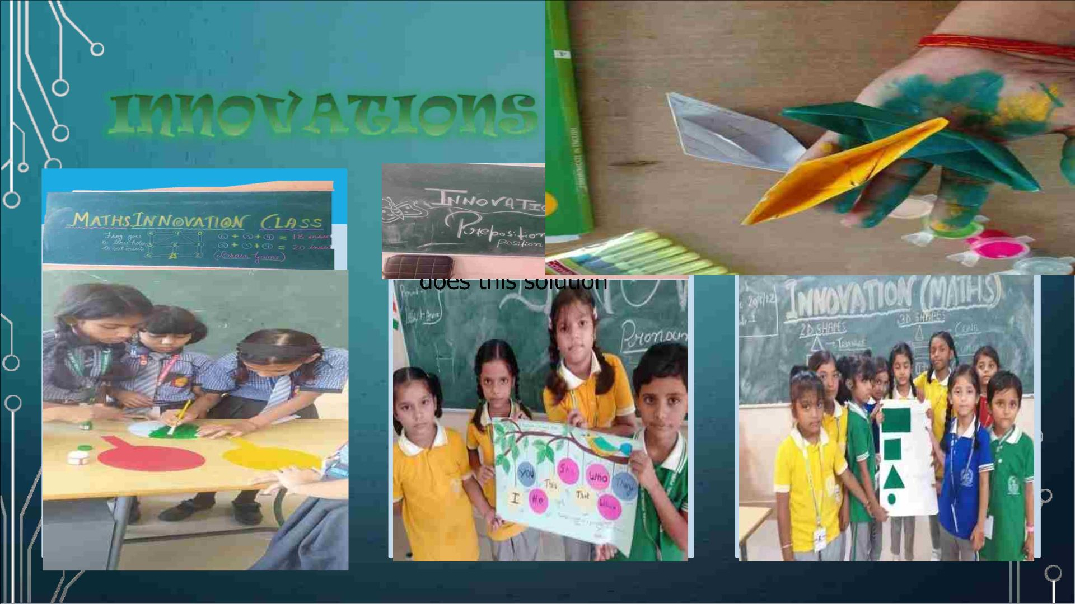
solution?
solution?

Slide 3

•OUR GIRLS ENJ OYED THE IR SA TURDA Y INNOVA TIONS
AND THEY GAVE NEW DIME NS IONS TO THEIR
LE A RNING BY CRE A TING S OME THING NEW . THIS NOT
ONLY HELP THEM TO BECOME CREATIVE BUT ALSO
A DDS ME A NING TO THEIR LE A RNING. THIS IS HOW
IPSITES ARE BUILDING UP A POOL OF RESOURCEFUL
TALENT FOR FUTURE INDIA.

Slide 4
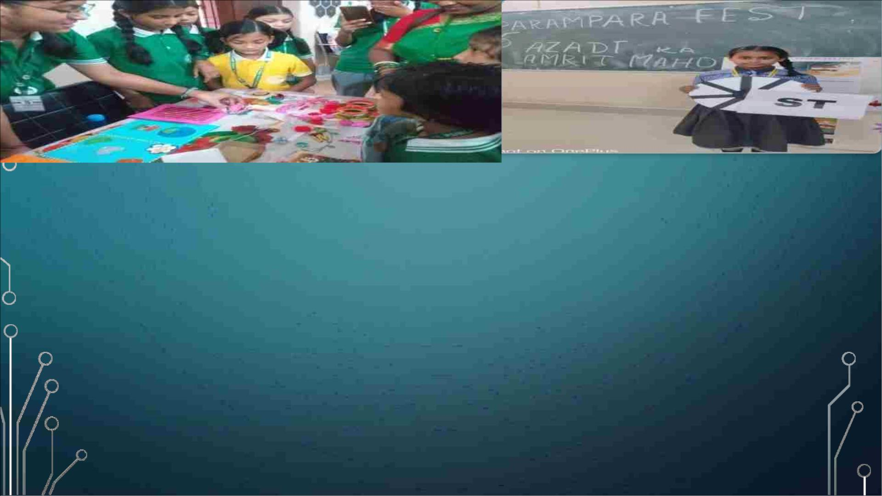
The Parampara cultural and Literary fest saw students portray themselves in different characters. They
spoke confidently adorning the attire of different characters. Their ease in the garb of those characters was
a rare sight. The bigger girls declaimed various famous luminaries of Pre independent and Post
Independent eras. They had stepped into the shoes of this famous personality with ease and poise The show
stealer was Palaki Sharma Upadhayay's gravitas plus news where Zoha confidently played the role of
Palaki with a pleasant demeanor. The recitation of the Poetry 'I am the massthe Mob" written by Carl
Sandburg reminded the audience of the power of the common man and how the crowd of the United could
bring about major revolutions. The poetry recital of'Hum panchhi unmukt Gagan' key depicted the
sweetness o f freedom. Poetry recitation helped them to understand the importance of voice modulation,
accent, diction, and fluency during recitation. Thus our girls spoke individually as well as in groups to
showcase their self-learning capacity, initiative, and collaborative efforts during this fest.

Slide 5
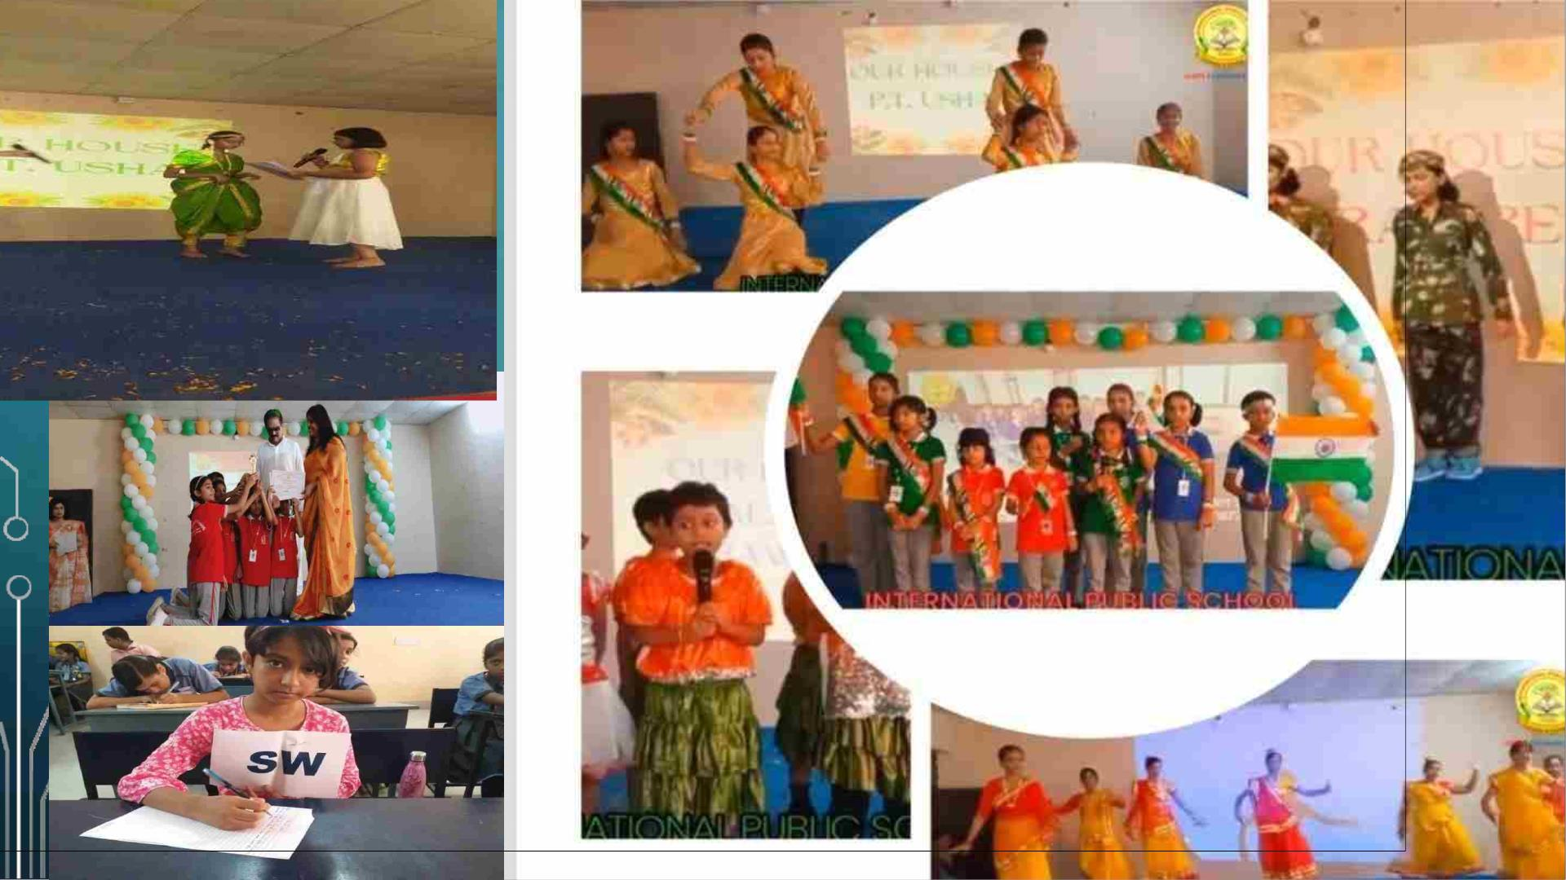

Slide 6
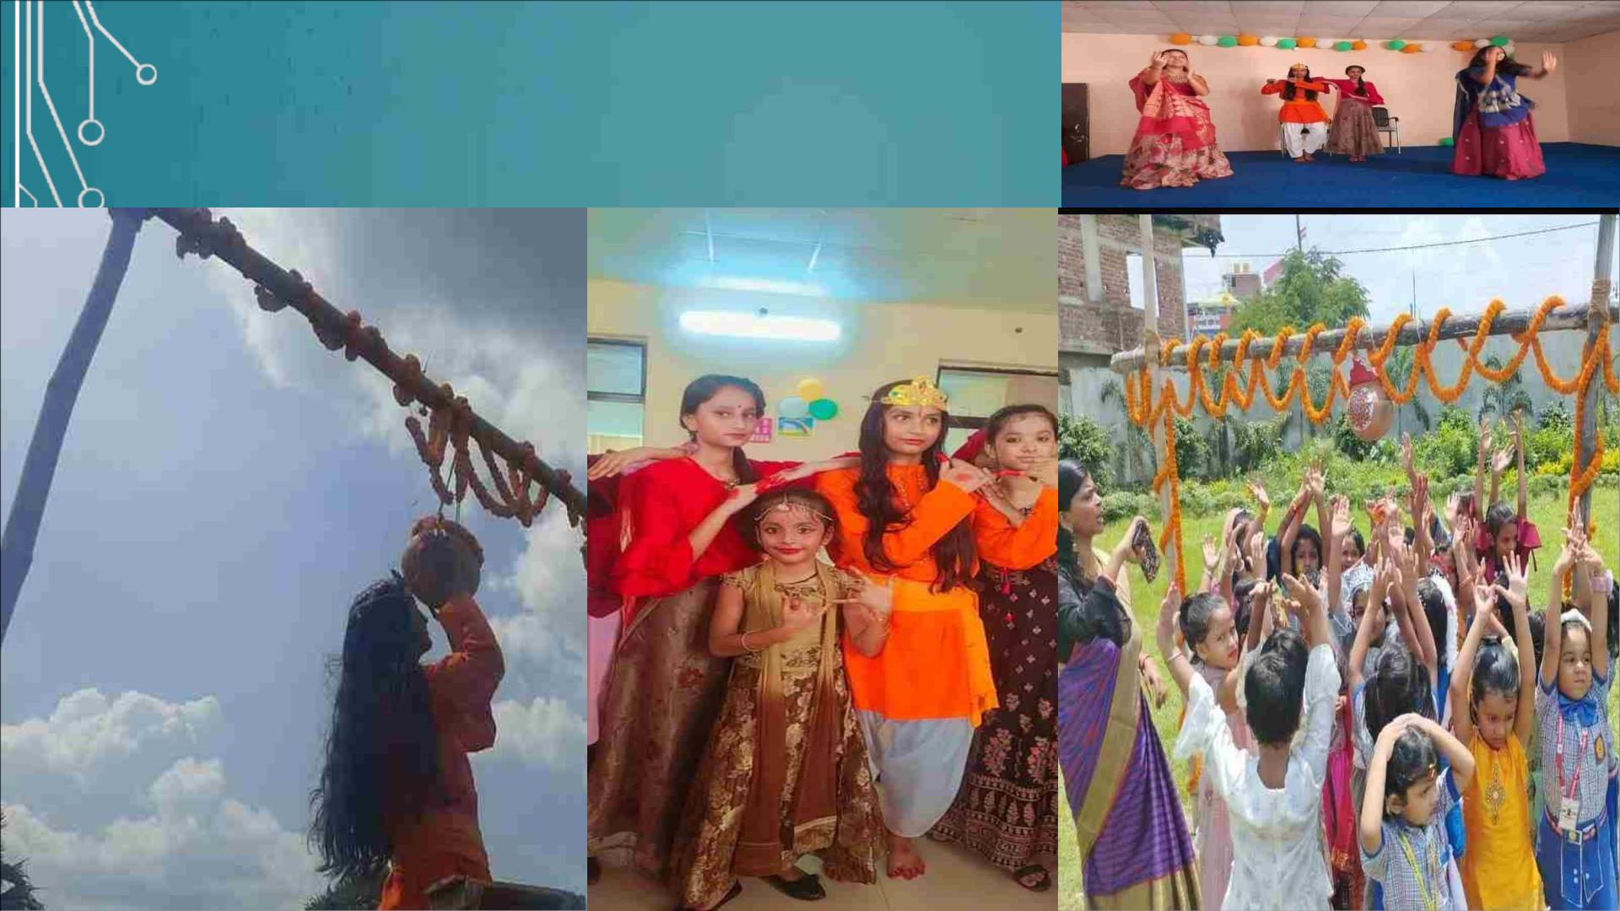
JANMASHTAMI CELEBRATIONS…

Slide 7

K R I S H N A J A N M A S H T A M I IS AN ANNUAL CELEBRATION OF T H E
B I R T H OF T H E GOD S R I K R I S H N A , T H E EIGHTH INCARNATION OF
LORD VISHNU. S H R I K R I S H N A W A S BORN ON T H E MIDNIGHT OF
B H A D R A P A D A K R I S H N A A S H T A M I IN ROHINI N A K S H A T R A . DAHI
HANDI IS AN I N T E G R A L P A R T OF T H E K R I S H N A
J A N M A S H T A M I CELEBRATION. DAHI HANDI R E P R E S E N T S T H E
W A Y LORD K R I S H N A L I V E D HIS LIFE. ACCORDING TO SCRIPTURES,
H E W A S V E R Y FOND OF B U T T E R AND CURD W H I L E GROWING UP. F O R
THE CELEBRATION OUR SCHOOL W A S DECORATED W I T H F L O W E R S
AND SWINGS. T H E T I N Y TOTS C A M E DRESSED UP A S R A D H A AND
KRISHNA. STUDENTS P R E S E N T E D SONGS,DANCE, AND S H O R T R O L E
P L A Y AND B R O K E T H E DAHI HANDI.

Slide 8
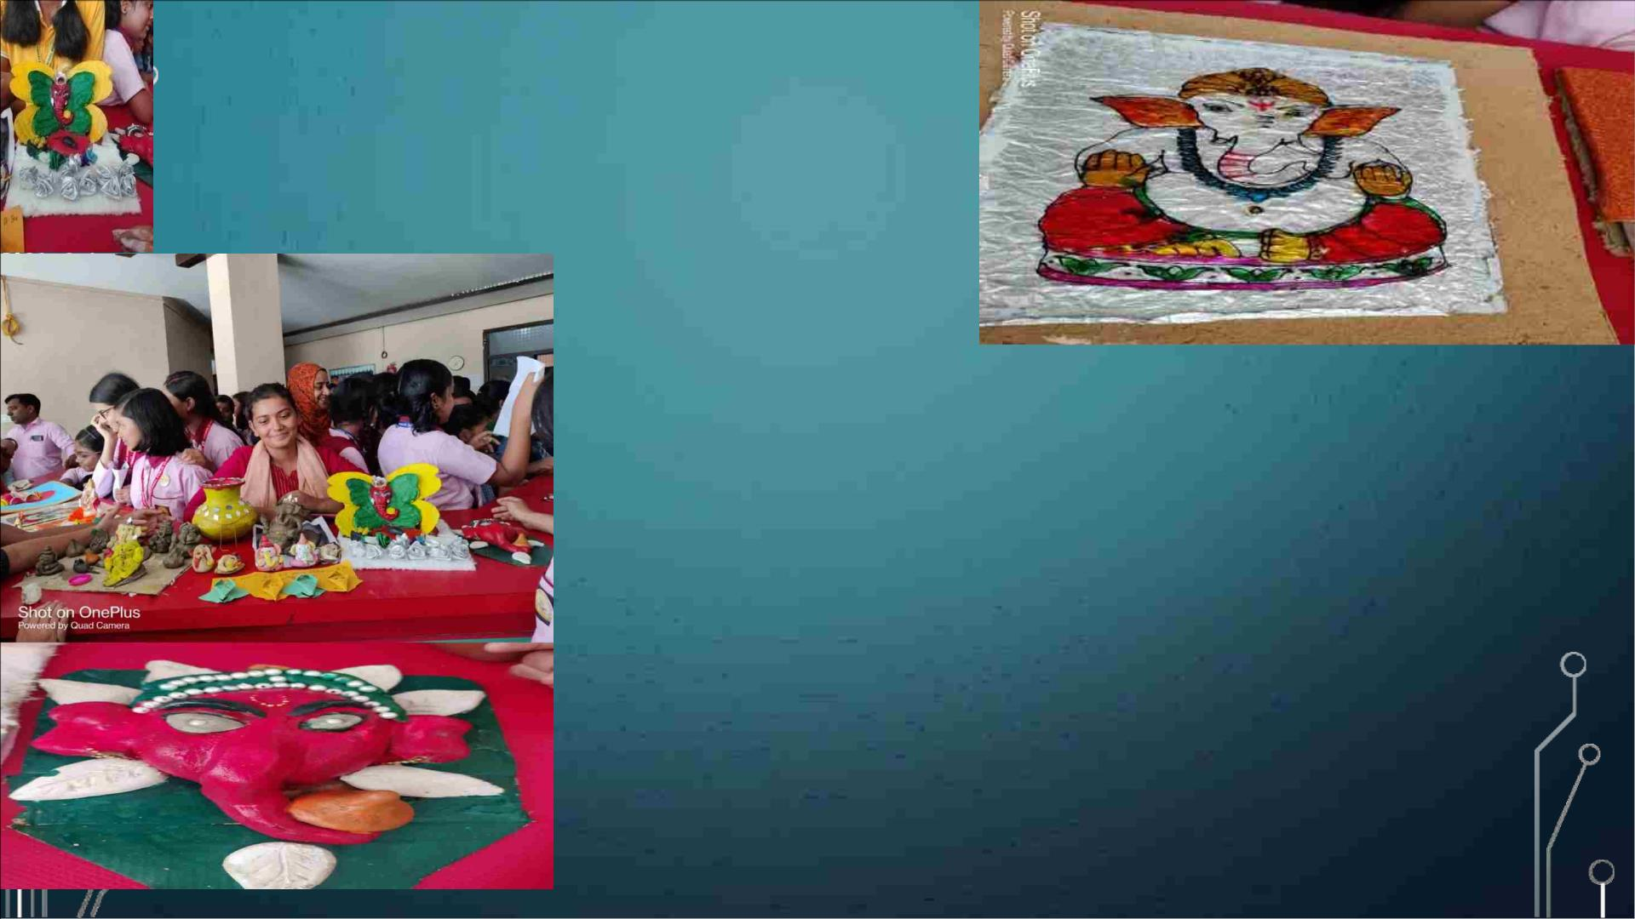
GANESH CHATURTHI
W ELCOMING THE VIG HNA VINASHAK W ITH ELAN AND
EN THUSI A SM . ALO NG W ITH MAKING IDOLS OF THE
COSMIC PROBLEM SO LVER LORD GANESHA. OUR G IRLS
LEARNED A NEW ART FORM TOO ,WHICH IS CREATING
SCULPTURES OUT OF CLAY. TH E IPSITES W ITH THIS
W O NDERFUL A RT FO RM HAV E MADE THE STAKEHO LDERS
REA LI ZE THAT SCULPTI N G CLAY IS AN EXCELLEN T WAY TO
IG NITE CREATIVITY IN KI DS.

Slide 9
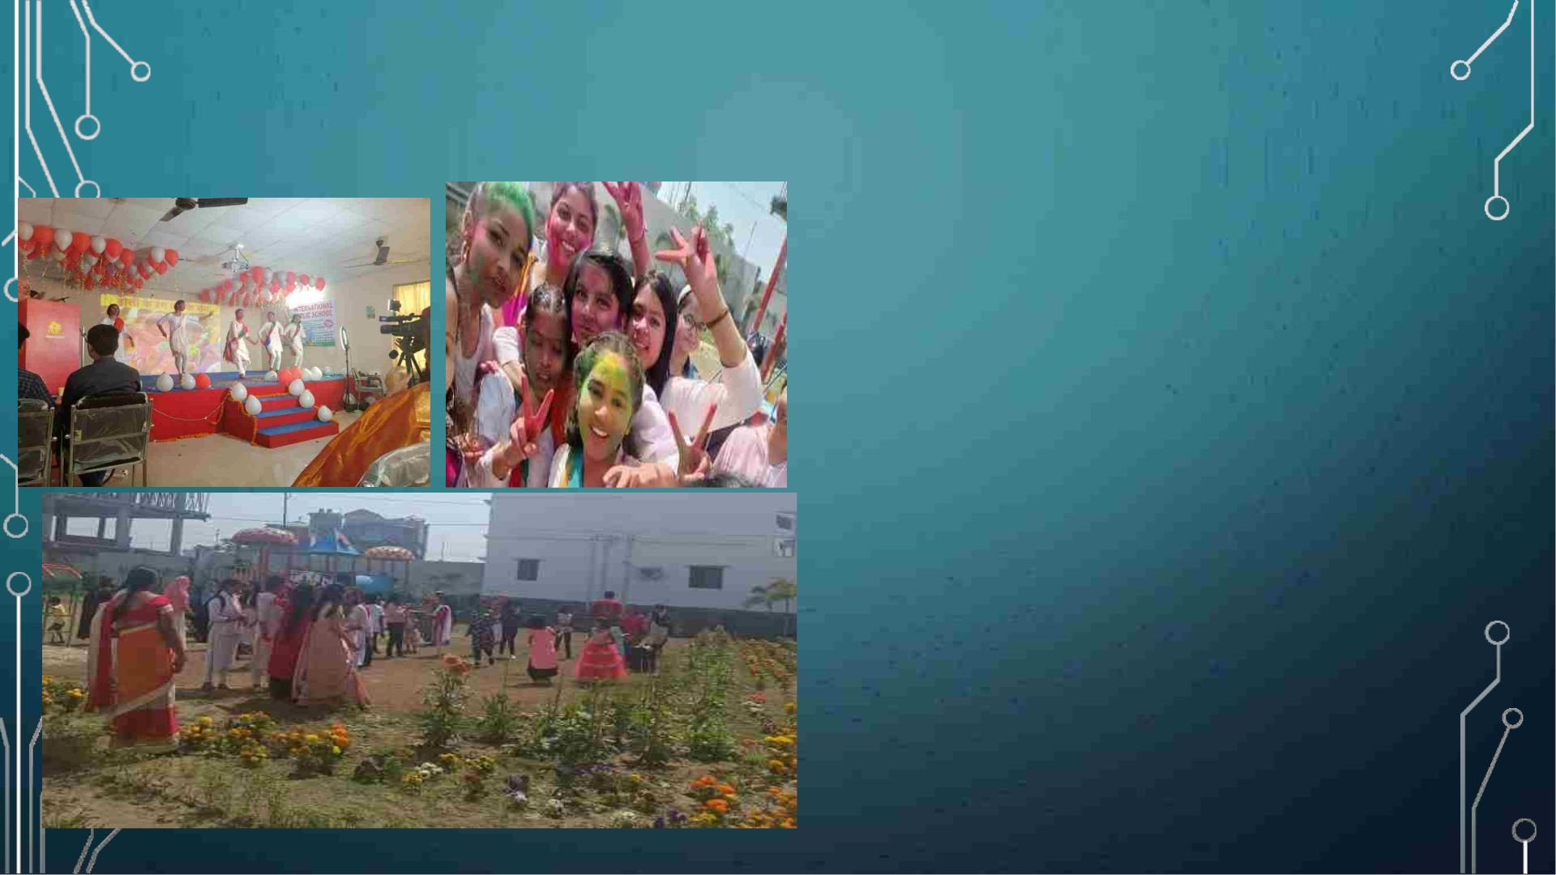
Holi Celebration
A day full of colours! A day full of excitement! A
day full of wishes! Yes, it’s Holi! A day to rejoice
love! Happy Holi”. Holi, the festival of colours, is
one of the most important festivals of India and
is celebrated with great pomp and flavour.
A day before Holi, Holika is burnt to remove
negativity and bring the colours of positivity into
our lives. The dominant idea behind holi is to
spread the message of harmony. To celebrate
this festival, a Special Assembly was conducted
by the students of class 1 to 10, and a beautiful
skit was performed deciphering the importance
of Holi and the safety measures required while
playing Holi.
A mesmerizing dance performance by the tiny
tots also enthralled the audience.

Slide 10
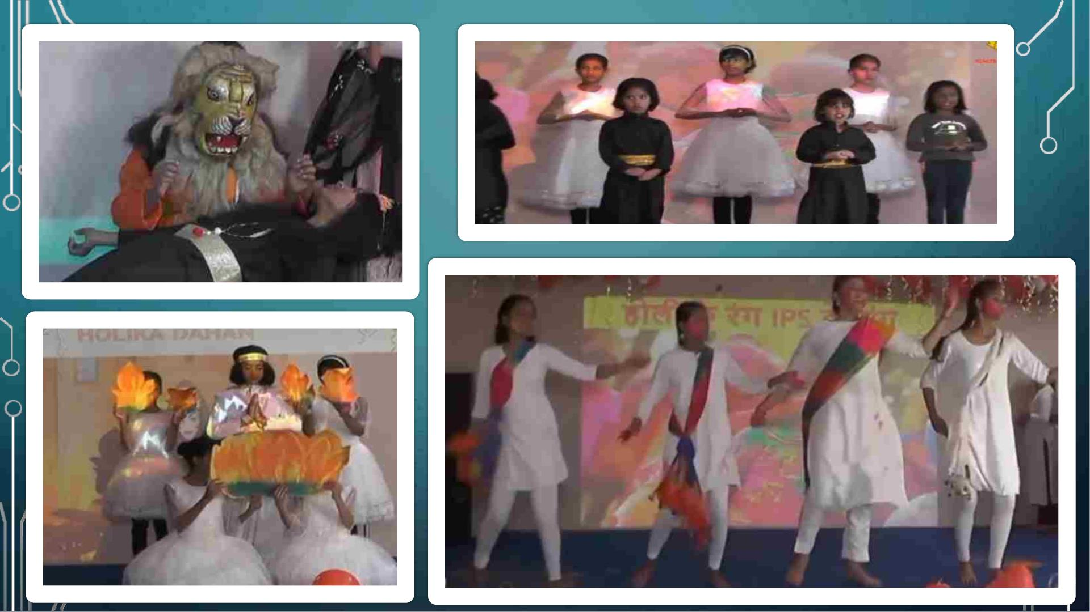

Slide 11
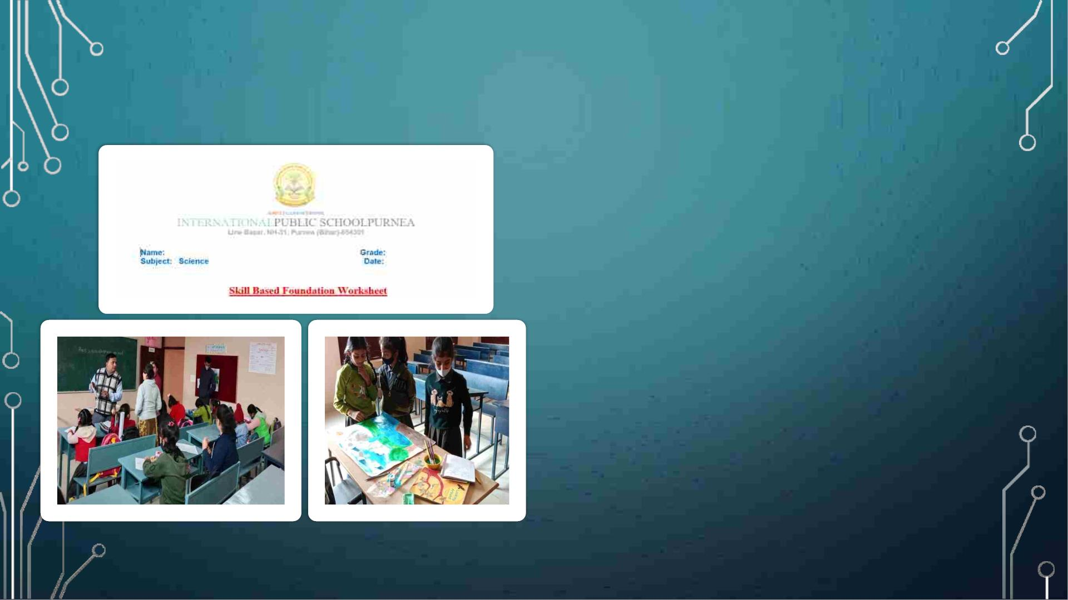
Foundation Course
You can't build a great building on a
weak foundation. You must have a
solid foundation if you're going to
have a strong superstructure.
In this foundation programme the gap
of the previous year are once again
reinforced so that new concept
becomes very easy for Students.
This helps us to improve our academic
skills.

Slide 12
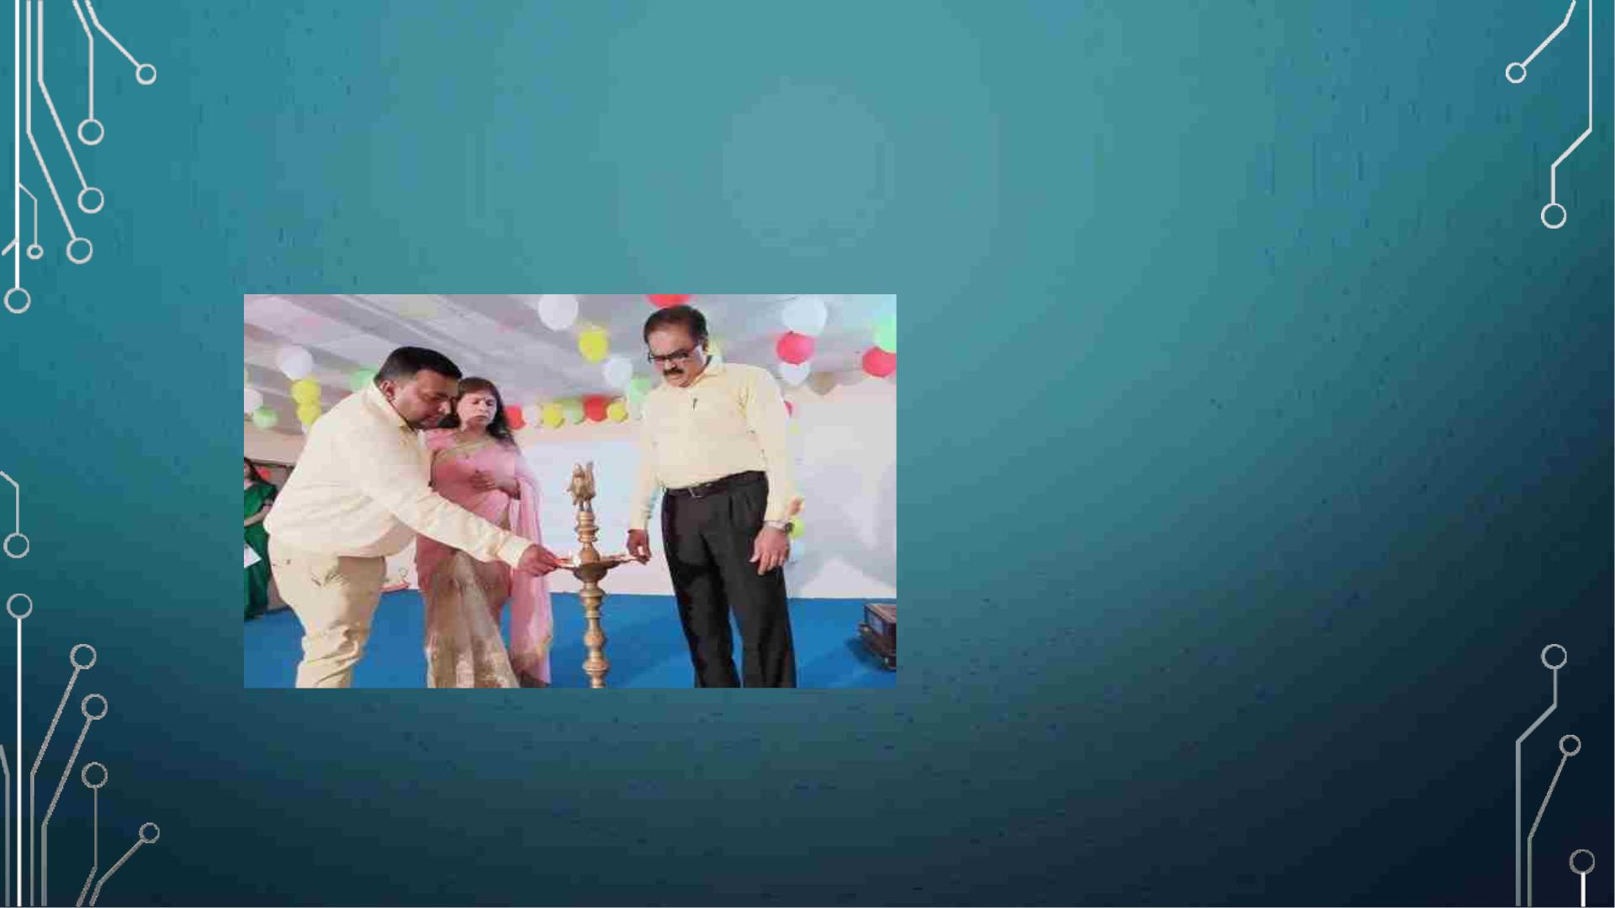
AAVIRBHAV
OUR STUDENTS AT
INTERNATIONAL PUBLIC
SCHOOL PAID A RICH TRIBUTE
TO THE NOBEL LAUREATE
RABINDRANATH TAGORE ON
HIS BIRTH ANNIVERSARY AND
ALSO ACKNOWLEDGED THE
SELFLESS LOVE, CARE AND
SACRIFICE OF THE MOTHERS
OUT THERE WORKING
TIRELESSLY FOR US WITHOUT
ANY REWARDS OR
APPRECIATION.

Slide 13
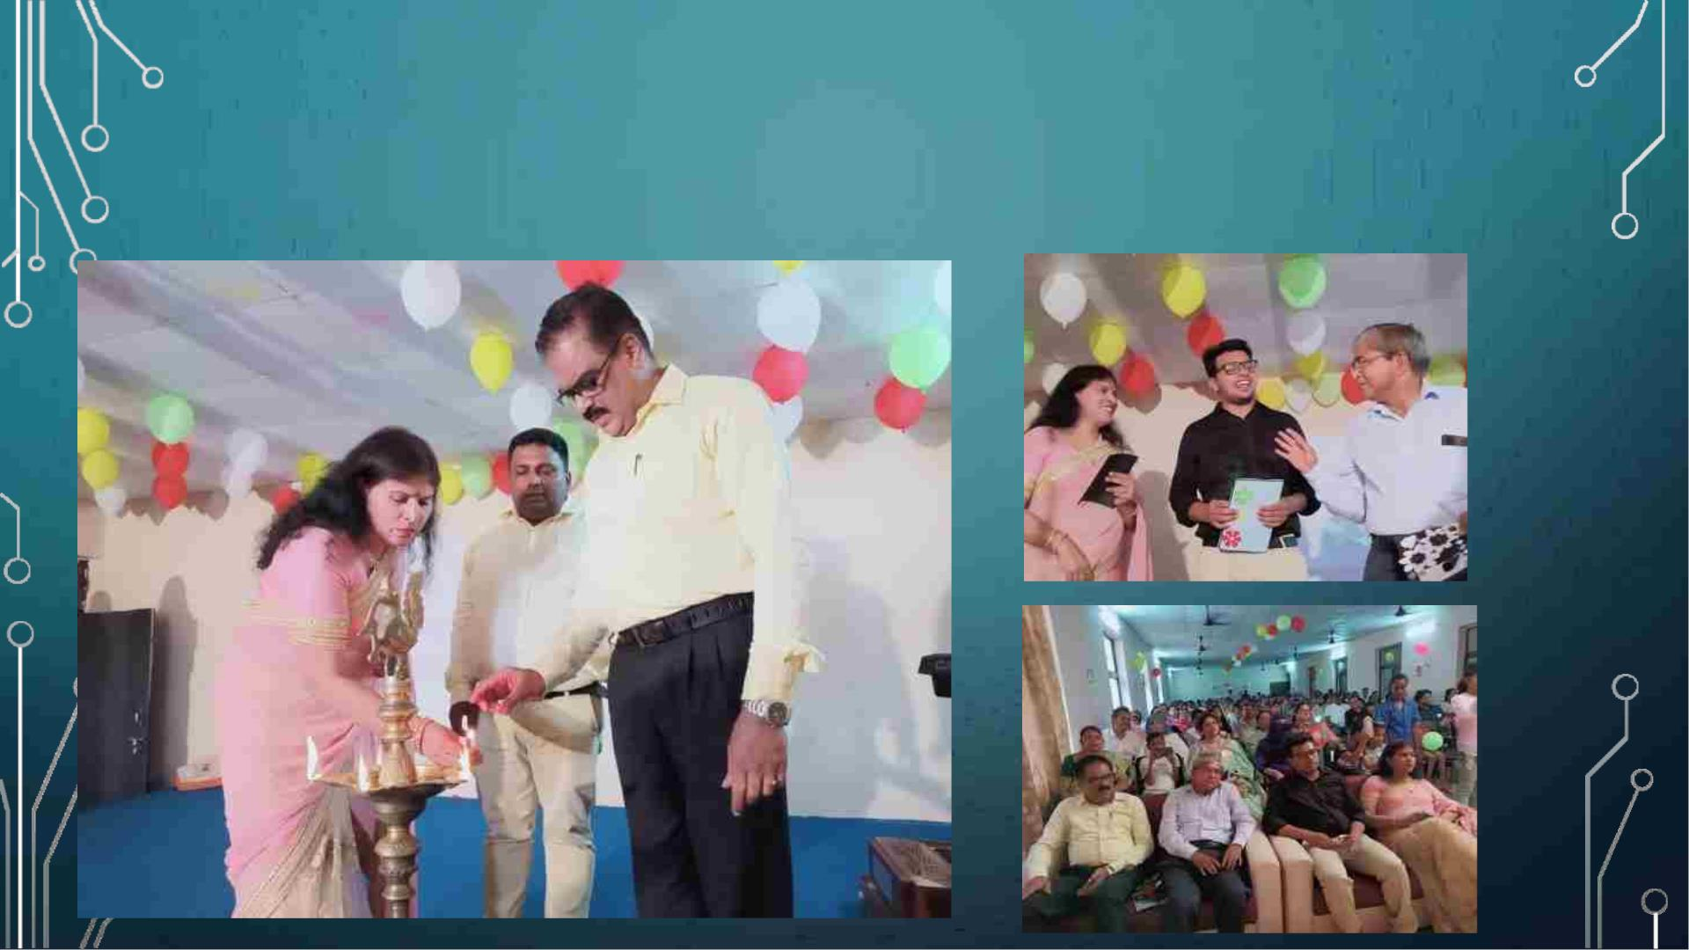
Some Glimpses of
Aavirbhav

Slide 14
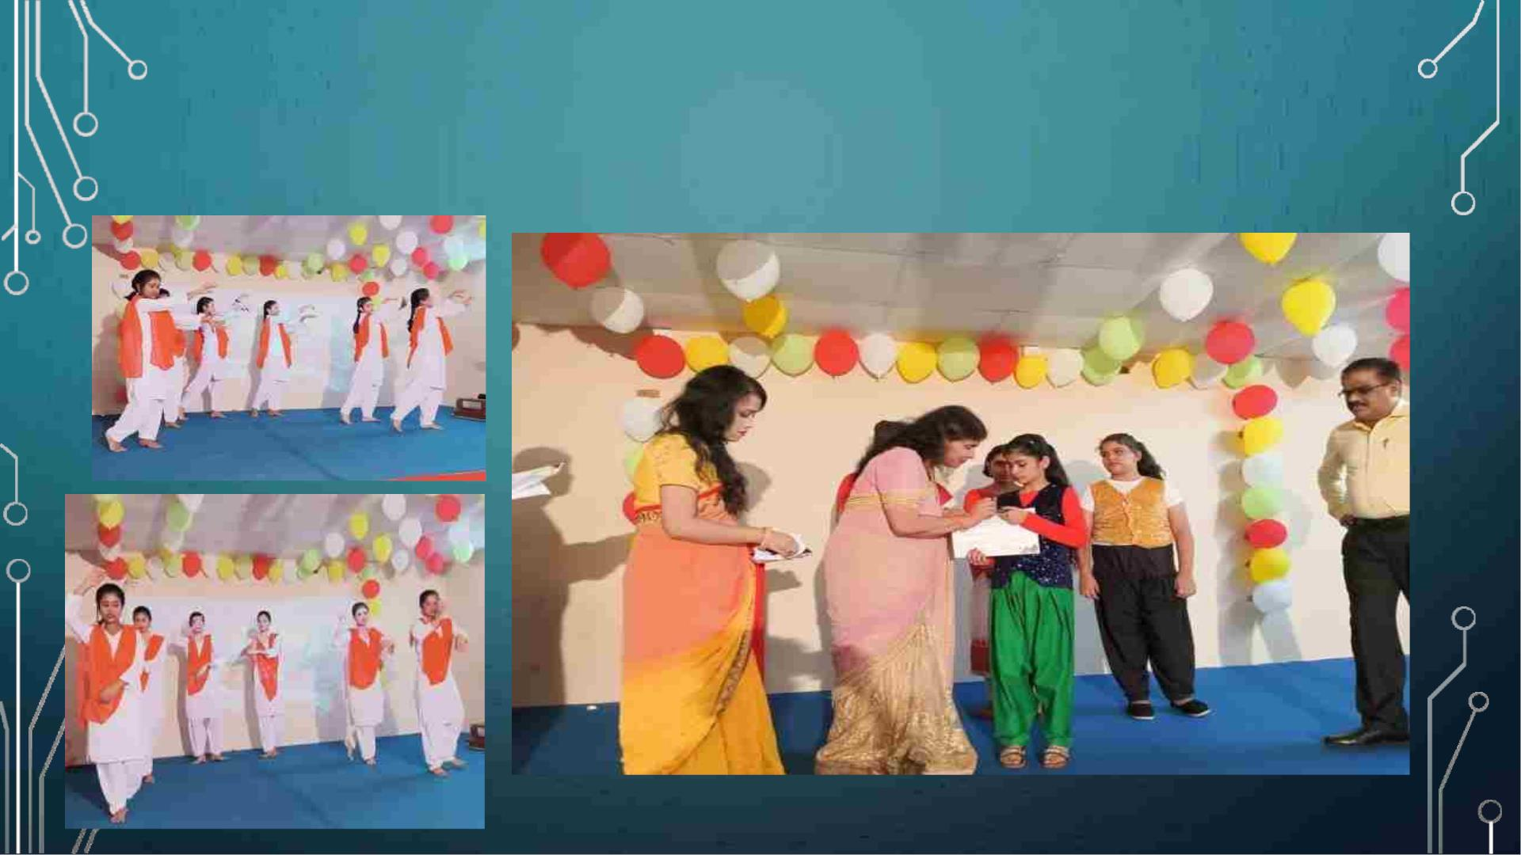
Highlights of Aavirbhav

Slide 15

SUMMER CAMP
Just before the onset of summer vacation
our school organized “COOL COOL
SUMMER CAMP” to provide relaxation to
our students soon after their Periodic test.
Students participated in different activities
such as dancing, singing etc. Soon after
the delightful lunch they watched movies
along with the teachers. They wrote diary
entry about their first ever experience of
the Summer Camp.
It was then followed by Rain Dance,
Bonfire, Dance and ended with the whole
some dinner provided by the school itself.

Slide 16
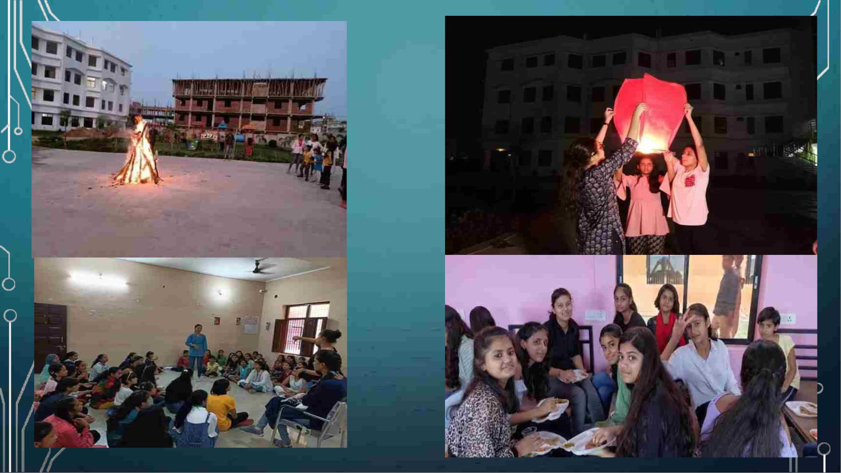

Slide 17
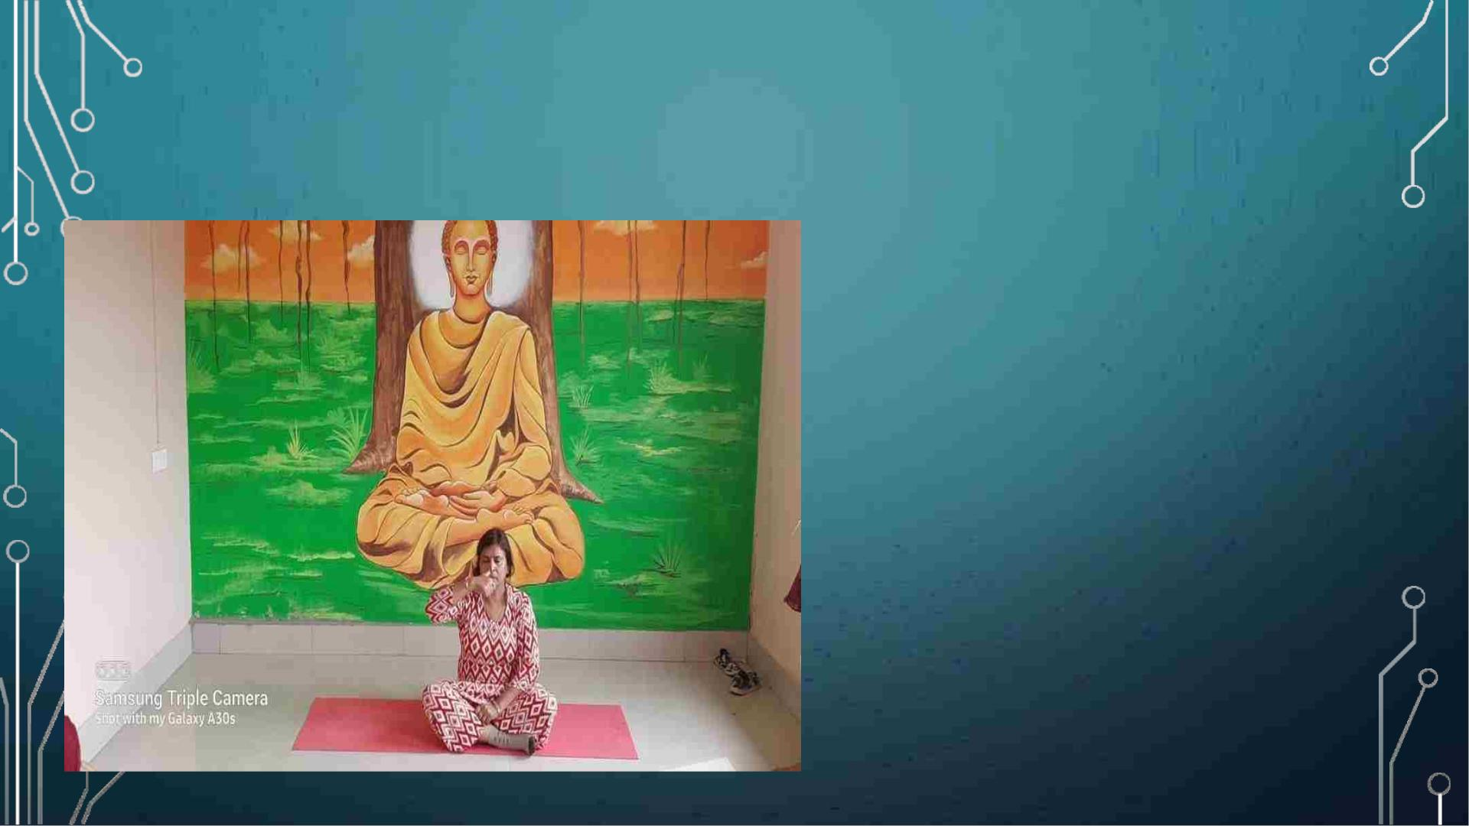
INTERNATIONAL YOGA DAY
Yoga is all about striking
balance in life We celebrated
International yoga day at
school with full enthusiasm
and vigour. Our Principal
ma’am took the charge and
students followed. Starting
with Warm up exercises
followed by Anulom Vilom and
several Asans. The importance
of these were also explained.

Slide 18
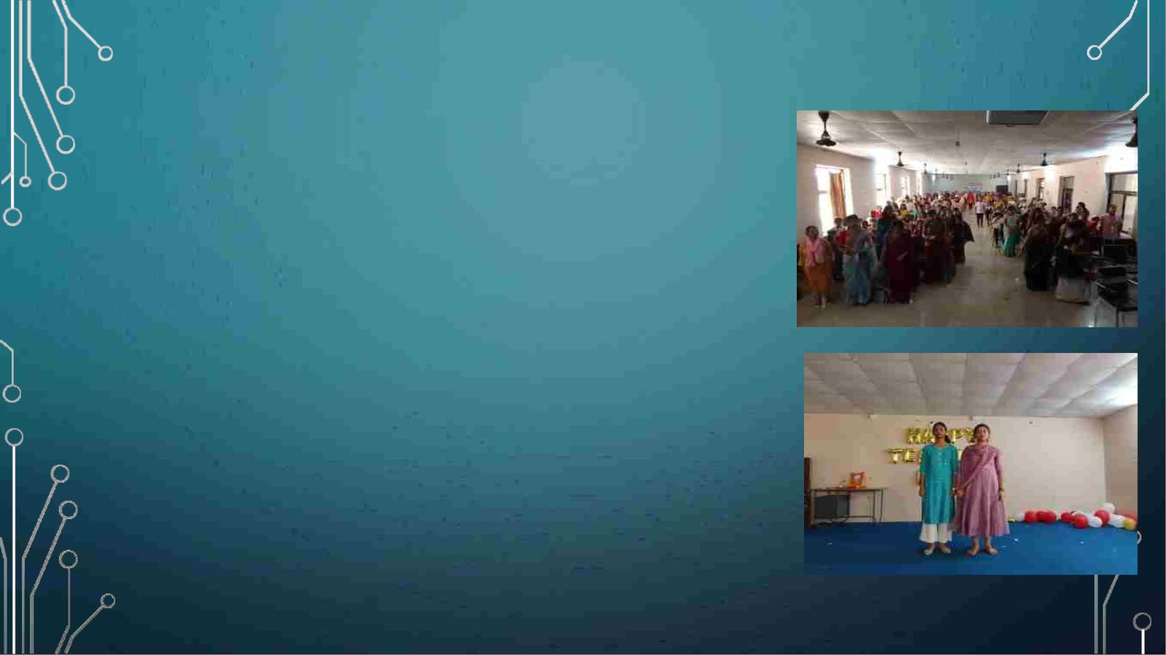
TEACHER'S DAY
Teachers' Day is celebrated on September 5 every
year in India to acknowledge the contribution of
teachers in the society. The day marks the birth
anniversary of India's second President and first
Vice President Dr Sarvepalli Radhakrishnan.
On this day all the Senior girls (girls of grade 9th
and 10th) were acting as their subject teacher
throughout the day plus the assembly was
conducted by the teachers and we learnt the
importance of teacher's in our life on that day.

Slide 19
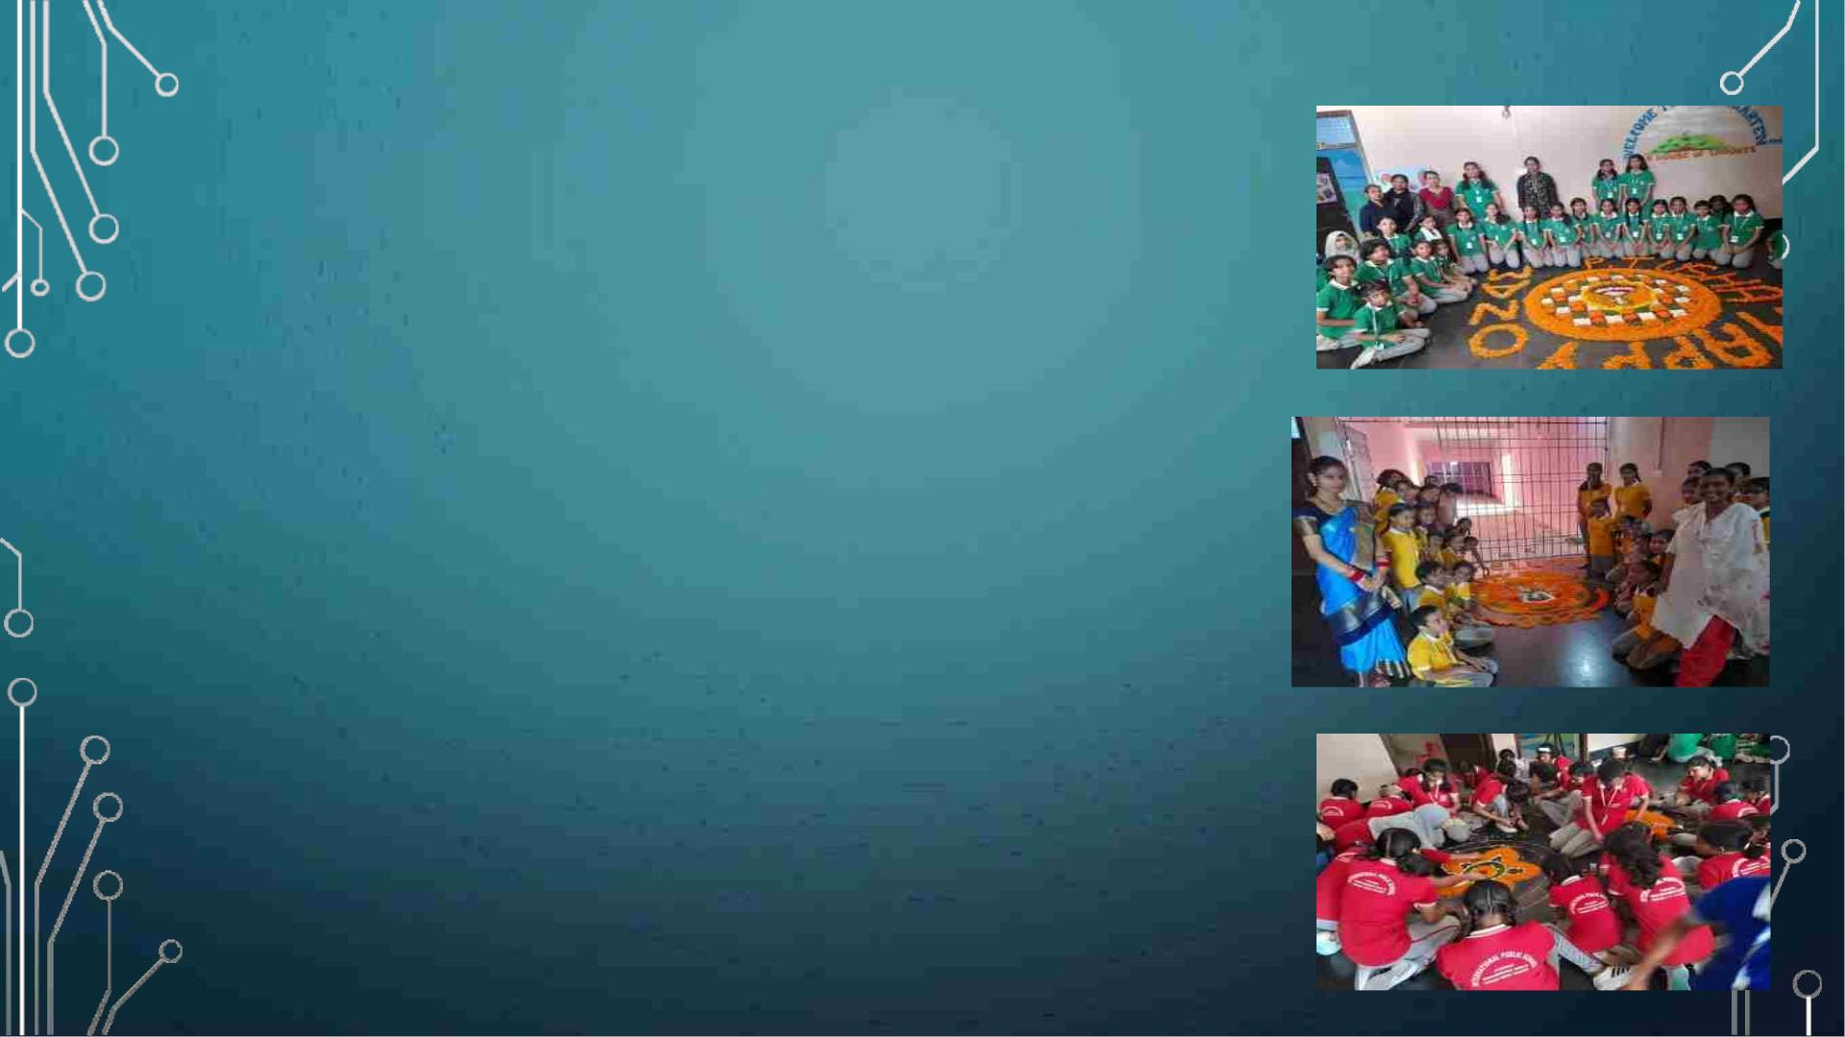
ONAM
Onam is a festival celebrated by Malayalis in
Kerala or in any other part of the world to
mark the visit of the Great King Mahabali. It
is also the mark of harvest season for
Kerala. In our school, we celebrate national
and international festivities so that we can
be aware of different cultures. On this, we
had a special assembly plus we have made
floral carpets with children.

Slide 20

HINDI DIVAS
Every year on September 14th,
schools, colleges, and offices across
India celebrate Hindi Divas to
commemorate the adoption of Hindi
as one of India's official languages.
On this day our assembly was
conducted in Hindi and we enjoyed it
very much plus we have written
slogans about importance Hindi.

Slide 21
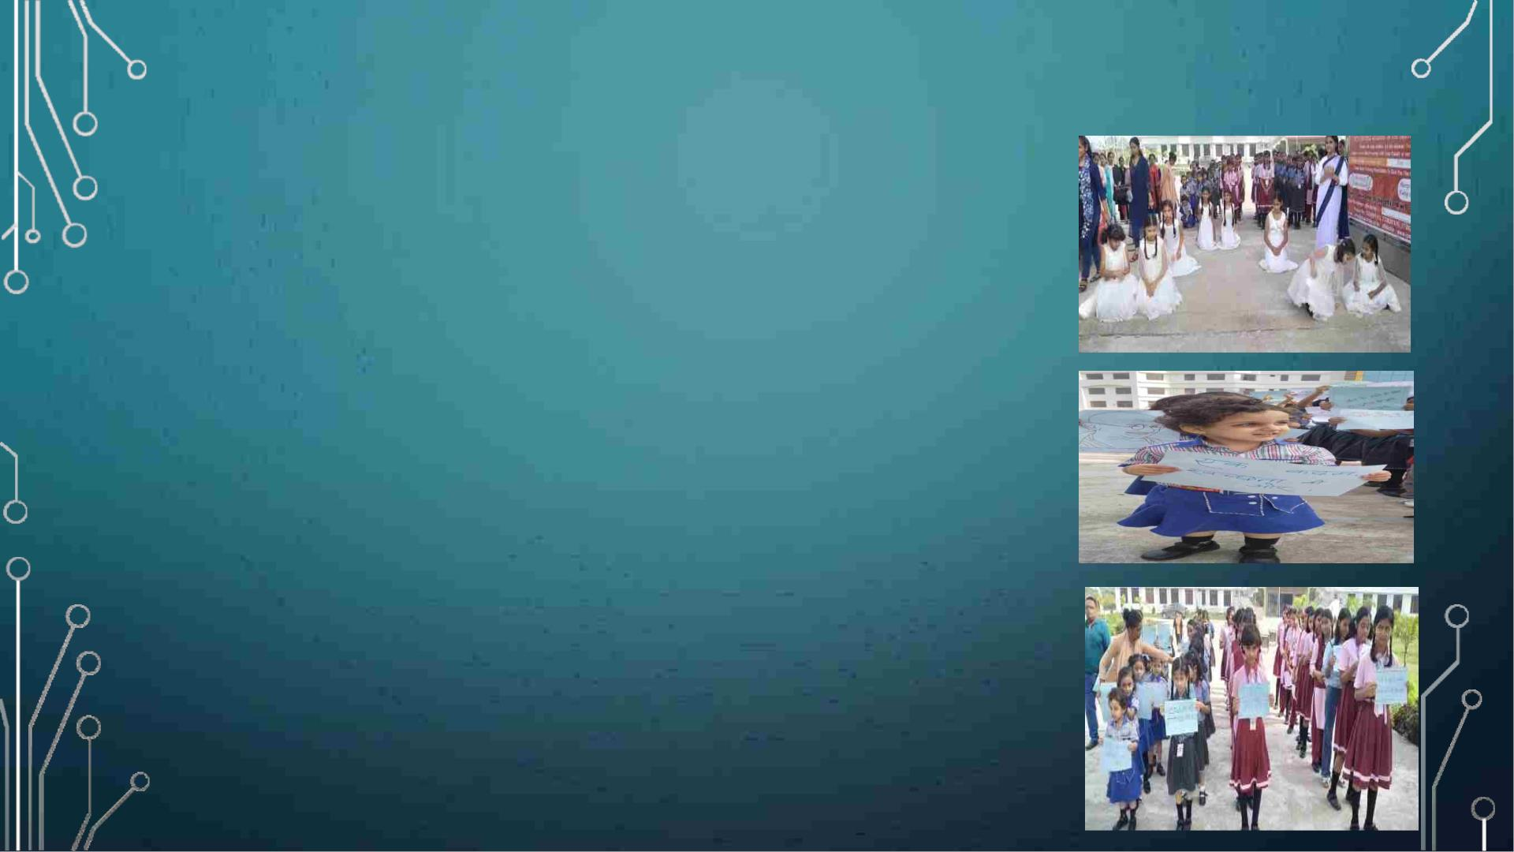
GANDHI JAYANTI
It was a day dedicated to the ‘Father of the
Nation’. Gandhi Jayanti is the celebration of the
birth anniversary of Mohandas Karamchand
Gandhi, popularly known as Mahatma Gandhi.
Mahatma Gandhi was a role model not only to
those who fought for India's freedom but also
people fighting for freedom the world.
On this day we had a small special assembly , we
have displayed some slogans of Gandhiji in public
plus we cleaned the school and learned the
importance of cleanliness and involved
themselves for this cause.

Slide 22
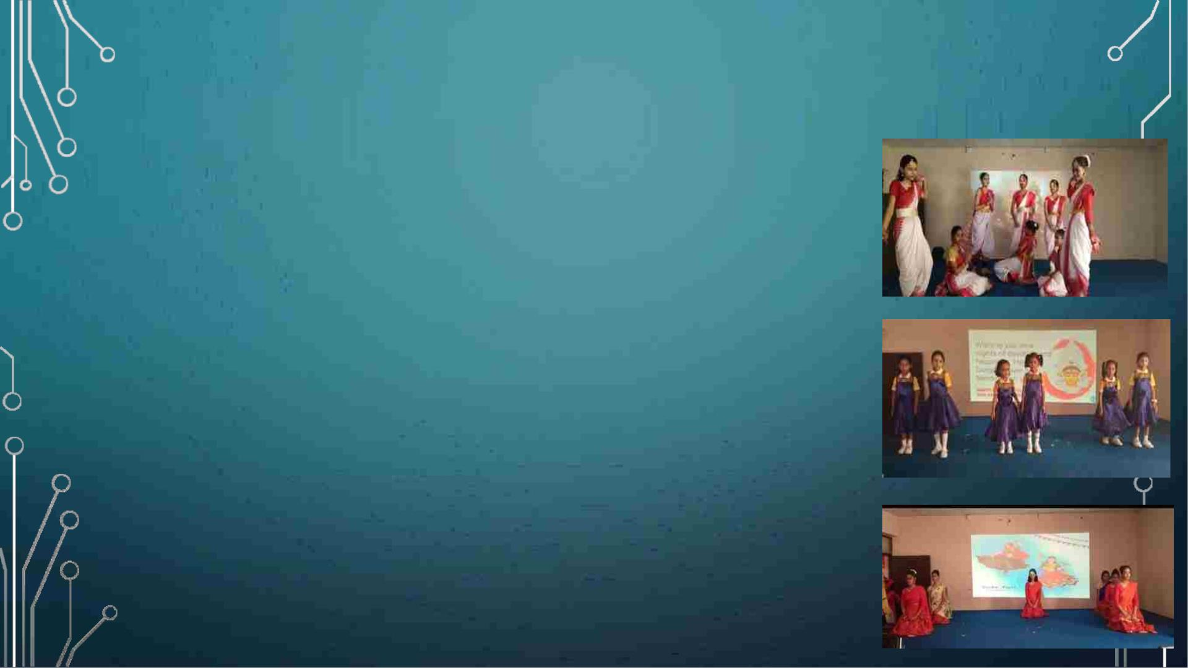
DUSSHERA SPECIAL ASSEMBLY
Dusshera is celebrated as the victory of Lord
Rama over Ravana. It also celebrates the triumph
of Goddess Durga over the demon Mahishasura.
In many places, the effigies of Ravana are
burned on this day to signify the destruction of
evil, along with fireworks. On this day, we had a
special assembly in which we have shown how
Durga maa defeated Mahishasura through a
dance performance and many more things we
have done on that day

Slide 23
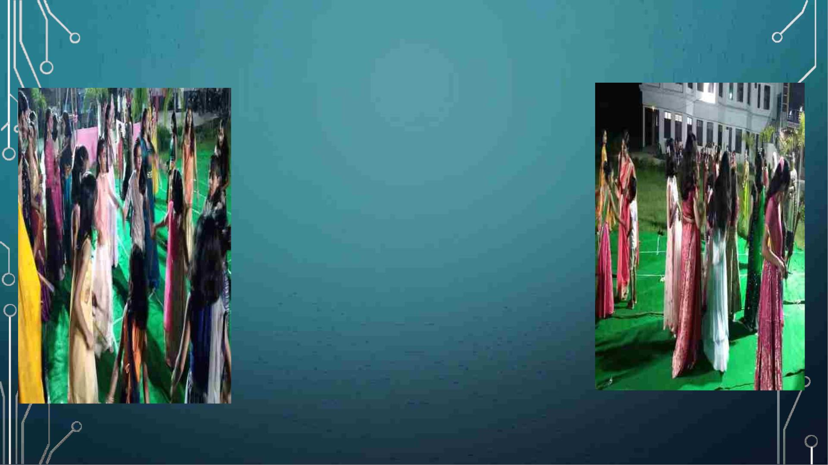
DANDIA NIGHT
On 1st of October night,
we have celebrated
dandia with our whole
IPS family. We have
really enjoyed a lot and
there were food stalls as
well.

Slide 24
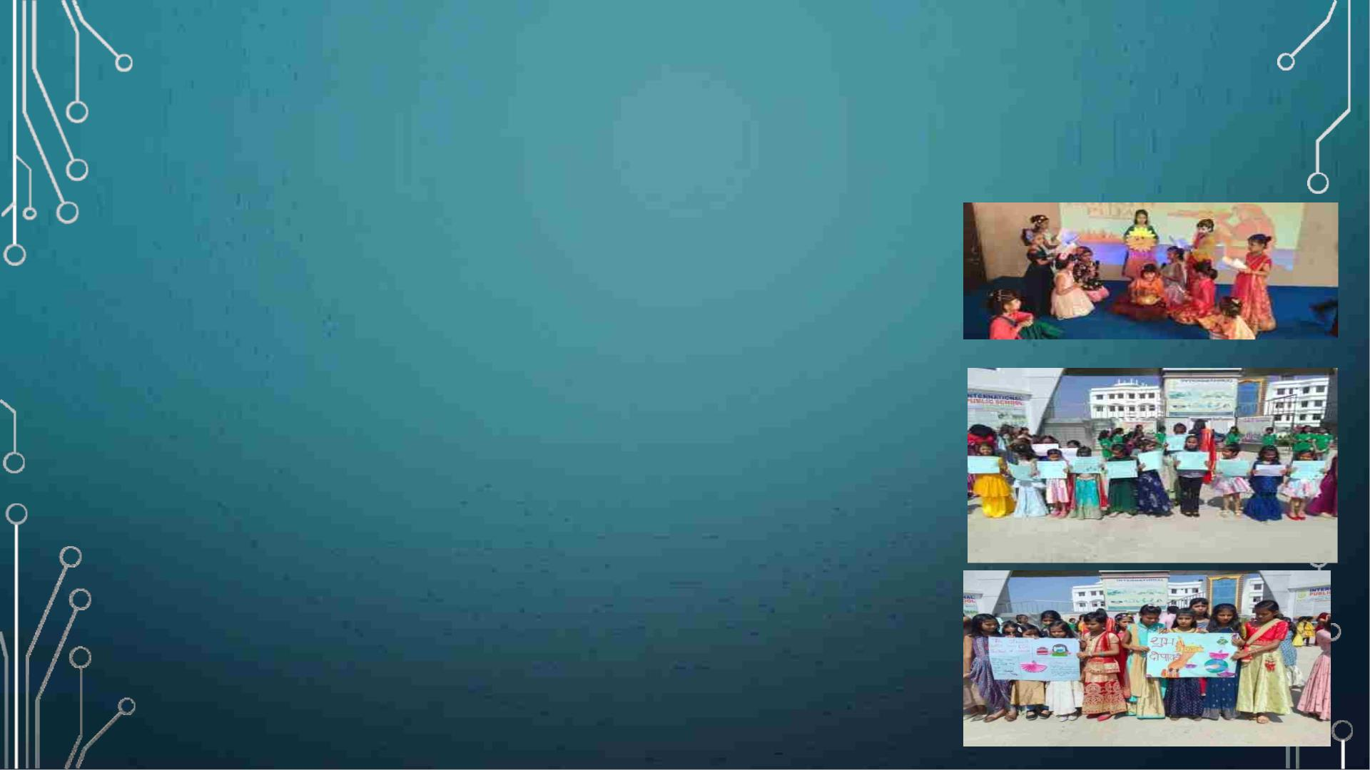
DIWALI SPECIAL ASSEMBLY
Diwali is becoming a global celebration and cementing Indian
identity globally. Diwali is not only celebrated in India but also in
other nations such as Indonesia, Malaysia, Fiji, Nepal, Guyana, Sri
Lanka, Thailand and Mauritius. The origin stories may differ but all
of them signify the victory of good over evil, light over darkness.
The tradition of celebrating Mahaparv Chhath Puja in Bihar is very
old and people here celebrate this puja with devotion for many
years.
We at IPS celebrated Diwali and Chatth with a special assembly
highlighting the importance of Diwali and chatth.
Special news and quiz related to Diwali, dance, music, rangoli
making Diya making , street play highlighting the importance of
green Diwali, posters displaying the importance of green Diwali
Diya lighting were the highlights of this special day.
All our activities were then linked with subjects like English,
Science, EVS, social science, mathematics in which we all
participated and enjoyed. It was a very subtle example of learning
beyond Classroom.

Slide 25

THANK YOU

